Slide 1
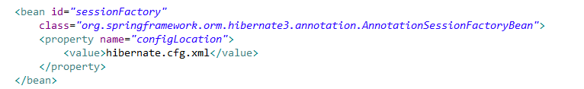

HibernateTransactionManager in Spring
HibernateTransactionManager handles the transactions in Spring.
HibernateTransactionManager belongs to the package org.springframework.orm.hibernate3.
The application that uses single hibernate session factory for database transaction, has good choice to use HibernateTransactionManager. HibernateTransactionManager can work with plain JDBC too.
HibernateTransactionManager allows bulk update and bulk insert and ensures data integrity.

Slide 2
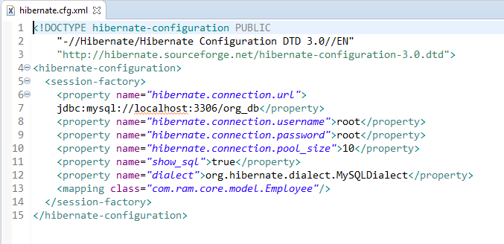
HibernateTransactionManager in Spring
hibernate.cfg.xml is an XML which consists all the database configuration. Database name, POJO mapping, username, password and other database configurations has been declared in hibernate.cfg.xml.

